Slide 1


Text To Speech Generation For Regional Languages
Mentor
Iftekharuddin Mohammed
Siddi Saranya
Nagaraju Ganna
III CSE B
M. Raj Kumar
Assoc. Professor
M.Tech, PhD, Dept. CSE
BATCH NO 16

Slide 2

Speech
The recent advancements in the speech processing domain are speech recognition, speech synthesis, speech analysis & coding. Speech synthesis is the artificial production of human speech.

Slide 3

TTS
A computer system used for the purpose is called a speech synthesizer & can be implemented in software or hardware products. A text-to-speech (TTS) system converts normal language text into speech.
This problem focuses on TTS for regional languages.

Slide 4

Applications
TTS applications are well known as assistive aides for people who experience dyslexia, reading challenges or visual impairment.

Slide 5

Real-time Applications
The other valuable uses for the application range from reducing eye strain from reading (digital or paper-formats), reducing paper use due to printing digital text, foreign language learning, writing and editing, or promoting listening skills.

Slide 6
Existing System
The initial work was done in MATLAB environment for TTS generation, one of the paper discuses Indian language TTS generation using MATLAB.
Many different Machine learning and deep learning approaches have been seen in recent years. Wave-Net is a powerful generative model of audio. It works well for TTS but is slow due to its sample-level autoregressive nature.
It also requires conditioning on linguistic features from an existing TTS frontend, and thus is not end-to-end: it only replaces the vocoder and acoustic model.

Slide 7
Disadvantages of Existing System
The existing system of speech uses Wave Net for training language data which is a slow process due to its regressive nature.
The response time of the TTS system is also slow

Slide 8

Proposed System
We proposed the method of using Google Text-to-Speech (gTTS) python interface.
It is a powerful speech engine for conversion of text to speech.
It can convert almost all the Indian regional language-text into speech in seconds.
Its application is also extended so that it can support not only India regional languages, but all the languages around the world.
An App can be made for different platforms like Windows, Linux, Mac, Raspbian, etc.
This application can help lots of visually impaired people to read text around them without human assistance.

Slide 9
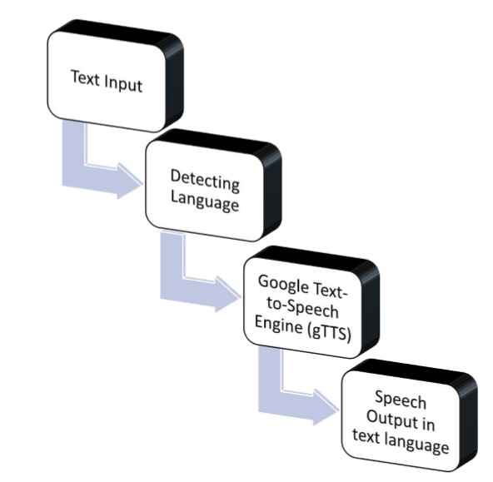
Workflow of RTTS

Slide 10
Workflow of RTTS
Text Input :- The User enters the text in any of the supported regional languages.
Detecting Language :- The detection of language is a key role in the project. It is responsible for language detection of input text and output speech. The ‘lang’ package of python is used for this feature.
Google Text-to-Speech Engine (gTTS) :- The gTTS is the base of the project. Models were trained by google on various languages to redefine the meaning of precise text-to-speech conversion. Refer Chapter 1 for further details.

Slide 11
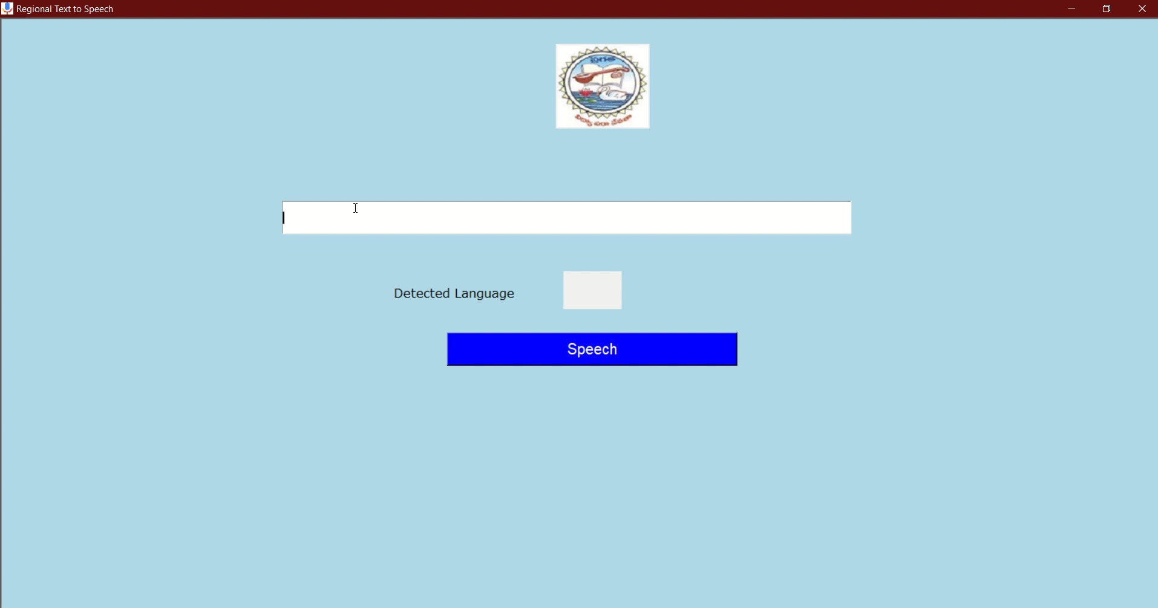
RTTS – Regional Text-to-Speech - Demo

Slide 12
Advantages of Proposed System
In 2017, the developed system in neural model is Deep-Voice, which replaces every component in a typical TTS pipeline by a corresponding neural network.
Each component is independently trained, and it’s nontrivial to change the system to train in an end-to-end fashion.
TTS is much faster and efficient as it uses Deep-Voice in the backend.

Slide 13

